Slide 1

Internship Experience
Mitra Innovation (Pvt.) Ltd.
U.D.P.D UDUWELA -18/ENG/112
Department of Computer Engineering
University of Sri Jayewardenepura
Notes:
Good afternoon everyone .
I am pasindu udwela and my index number is 18/Eng/112
Today I am going present my internship experience at mitra innovation pvt ltd..

Slide 2
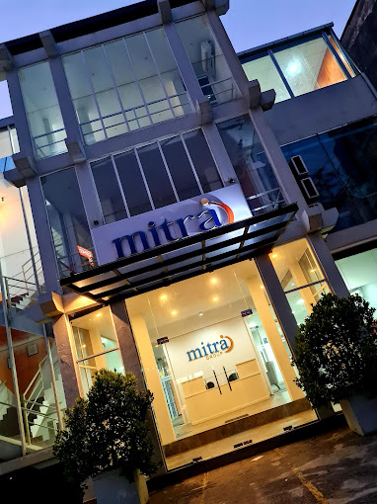
Content
Training Establishment details
Placement Details and Scrum Team at MitraI
Assigned projects
Project1 Details
Project2 Details
Technical and Non-technical skills

Slide 3
Training Establishment details
Vision
Which is to help entrepreneurs and enterprises build and launch disruptive technology solutions.
Mitra Innovation is a Technology Innovation based company in Sri Lanka, Australia, the U.S. , and the U.K.
It has two central business Units. They are-
Mitra Digital - Focuses on software service delivery
Mitra Ventures – Focuses on product innovation and partnerships with other joint ventures
Mission
Which is to help as many successful products and ventures as possible.

Slide 4
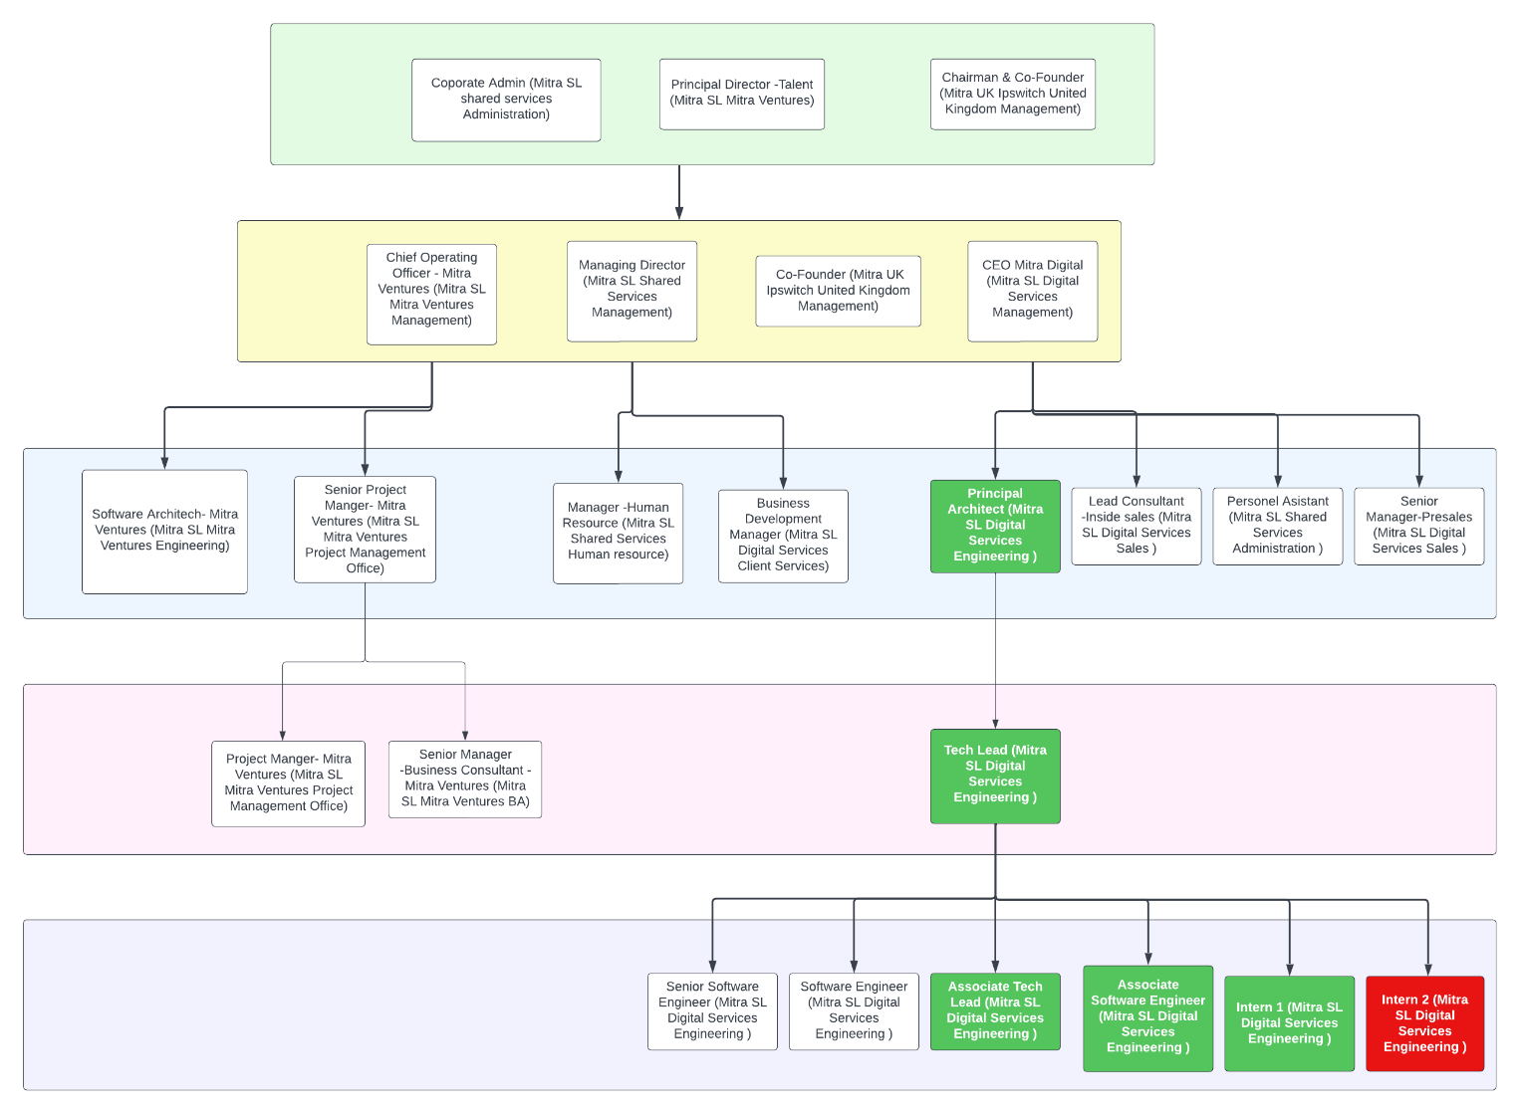
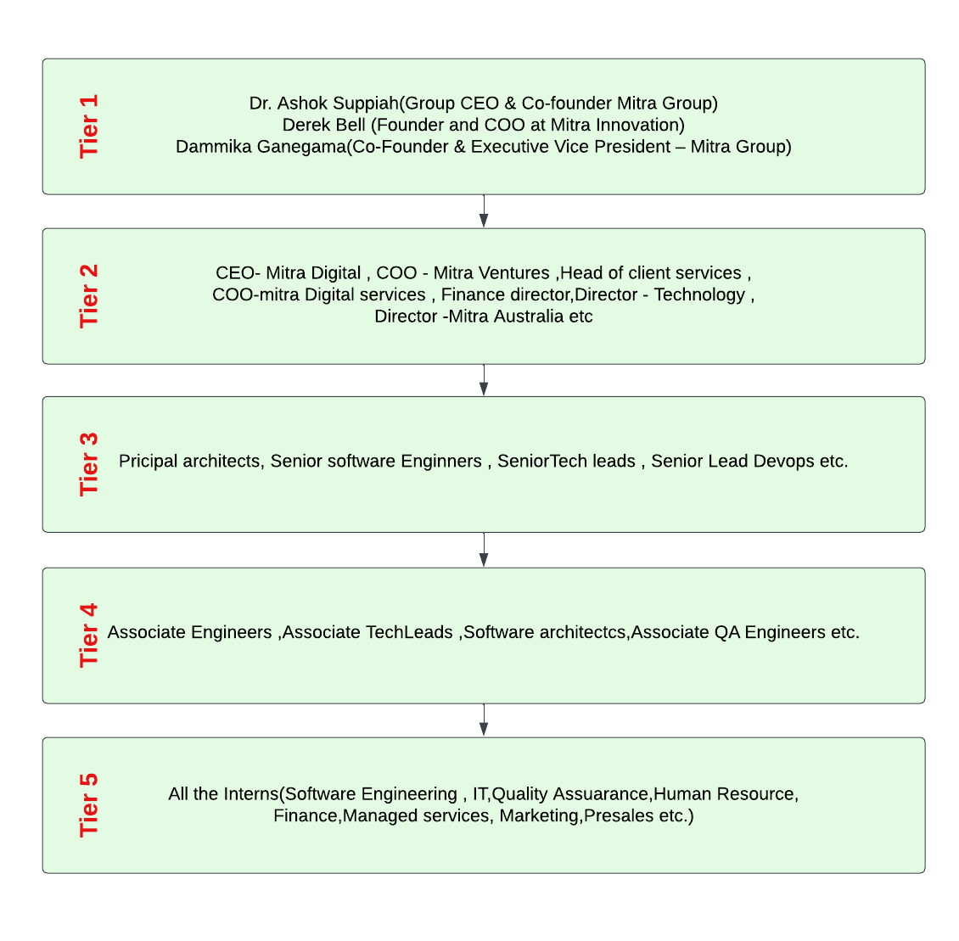
Placement Details and Scrum Team at Mitra
Notes:
This tree was use to show the currently working teams and the the members.

Slide 5
Assigned Projects
TRITON-(Client Project)
Triton is a Cloud Security Posture Management (C.S.P.M.) tool that will be developed with the intention of helping customers to secure their cloud environment by automating security, to reduce that attack surfaces, fix misconfigurations, resolve configuration drift, block unwanted behavior, and keep threats at bay.
ATS –(Internal Project)
ATS is an Applicant Tracking System(A.T.S) web dashboard proposed to developed for the Mitra Human Resource Department .

Slide 6
Triton
Notes:
------------------------------------------------------------------------------------------------------------------------------------------------------------------------------
As one of Mitra Innovation's main departments, the Human Resource Department is critical in recruiting employees for available positions in the organization. Currently, the Human Resource Department's staff manually maintains the Records of Recruitment with the association of the PeopleHR application. Since Recruitments take place often, it becomes a tough job for the officials to maintain a higher level of accuracy along with good efficiency and confidentiality in updating them into the system. Also, there are high chances of encountering data losses and erroneous entries since they are done manually.
-------------------------------------------------------------------------------------------------------------------------------------------------------------------------------
To address the above-mentioned drawbacks and difficulties in the existing system, it is suggested to develop a web application that replaces the current manual data capturing and visualization of the recruitment process. Department expects to maintain the recruitment process by overcoming overheads in the existing manual system and visualize the statistics associated with recruitments over months and weeks. -------------------------------------------------------------------------------------------------------------------------------------------------------------------------------

Slide 7
Triton Stake holders
Mitra stakeholders | Shimantha Perera(Project Manager) ,Thilina Herath(Principal Architect), Deleema Fernando(Tech lead), Reshan Perera (Consultant Engineer),Tharindu Madushanka(S.S.E. (Angular)),Dinura Marsinghe(Q.A.), Kithsiri Ekanayake(UX/UI Designer),Purni Gunawardana(Business Analyst),Tharun Krishnamurthy (Associate S.E.), Saduni Maduhansani(Associate S.E.), Pasindu uduwela(Intern S.E.) , Kavish Rajakaruna(Intern S.E.)
Dygisec Stakeholder | Stefano Harding(Product Owner), Lakshitha Herath(co-owner), Chanditha Samaranayake(Project Sponsor), Rajesh Rasiah(Risk & compliance)

Slide 8
Prior Knowledge and Works
I was assigned as a Golang back-end developer by evaluating my all past projects.
I was given two week period to familiarized with Golang , docker and Kubernetes.
Before Going to the Task-01 I have to fully setup the WSL (Windows Subsystem For Linux) working Environment on my given office laptop. I have Installed Followings on it.
Golang 1.17.7
Vscode extensions- Docker ,WSL , Kubernetes , Angular
Docker hub and Minikube etc.
Cloned the Triton back-end repository from GitHub and I have to resolve all errors.
Practiced more with git commands.

Slide 9
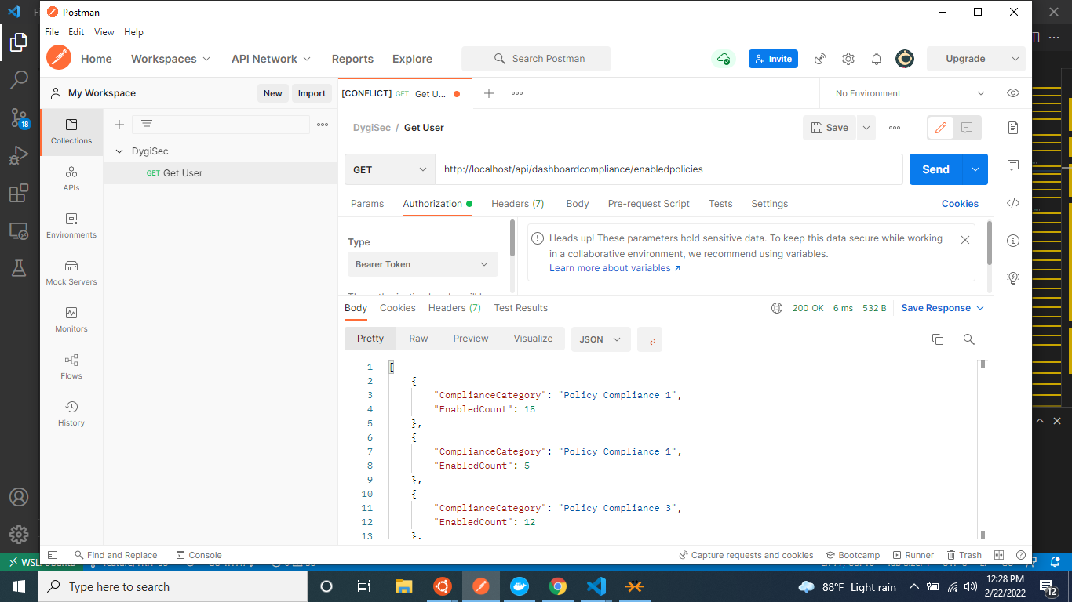
TASK-01
In this task , I have to create API endpoints for the compliance dashboard service to retrieve some hard quoted data from the back-end.

Slide 10
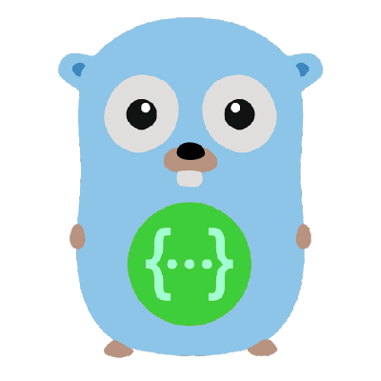
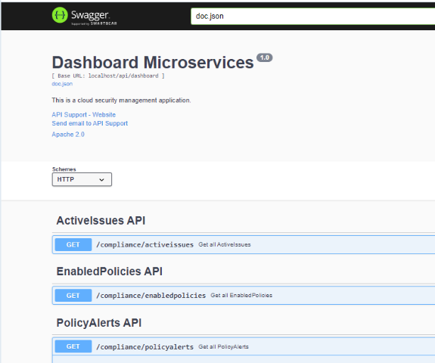
TASK-02
All REST API endpoints in the project should be documented using Swagger UI.
First, Import the necessary packages to the handler. go file
Added the General API annotations in main.go file reserved for each service
Added the API annotation in the handler.go file
Execute the correct swag init command in correct directory path with the correct command options and arguments.
Follow the same steps for all other build completed services parallelly with other assigned tasks.
Notes:
Swag converts Go annotations to Swagger Documentation 2.0. We've created a variety of plugins for popular Go web frameworks. This allows you to quickly integrate with an existing Go project (using Swagger UI).
Later I covered sawagger UI for all
dashboard services
notification services
policy service..

Slide 11
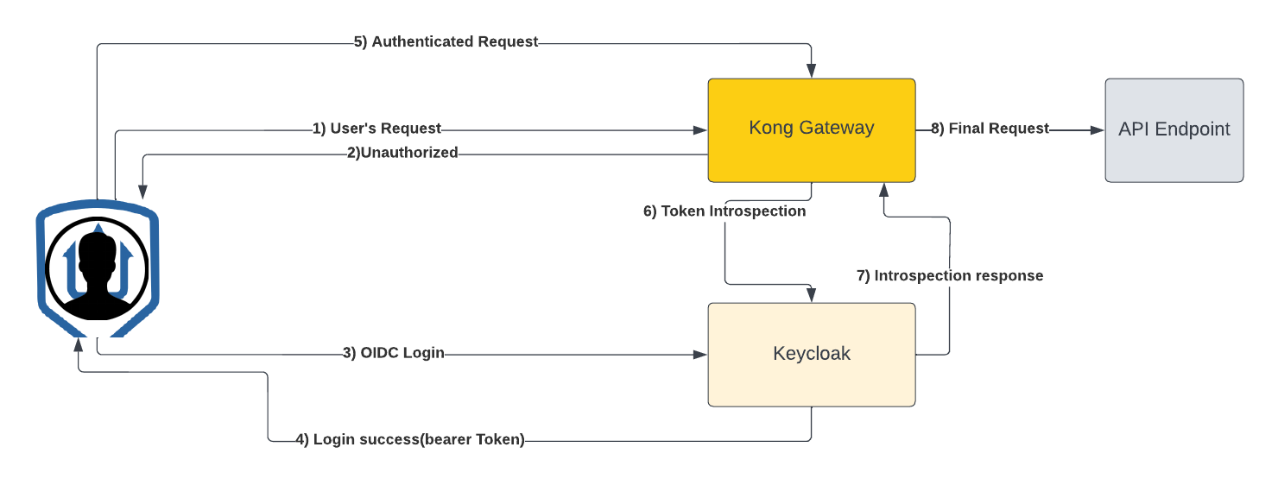
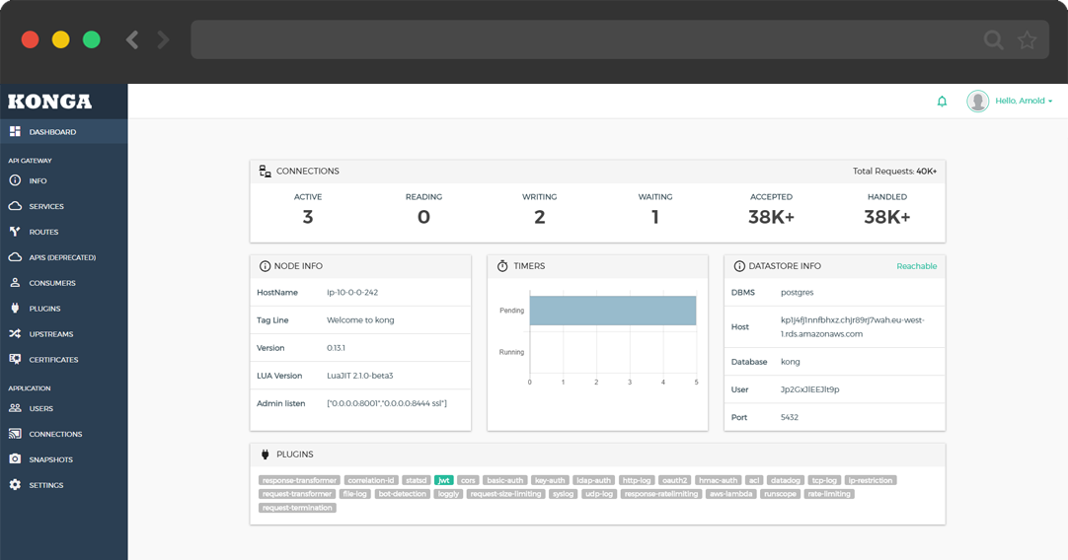
TASK-03
I was assigned to a research to build an OpenID connect & OAuth2.0 plugin for the Kong gateway.
Notes:
Table 5-Details On Kong Gateway, Keycloak, and Microservice architecture
----------------------------------------------------------------------------
API MANAGEMENTKong API Gateway-2.7.0
Provide Open APIs for internal consumers.
Portal for API creators.API Lifecycle will be managed here
Portal for API discovery and subscription
API Rate limiting and throttling
--------------------------------------------------------------------------------
Identity Management- Keycloak Identity server-16.1.1
Centralized Identity Management Solution
Manage all the identities of the system users
Manage MFA (multi–Factor Authentication) to enhance the security
---------------------------------------------------------------------------------
Microservices
1)Kubernetes Platform-1.23
Provide business logic-related microservices applications
Domain Models
Event sourcing capabilities for future extensions.
2)Container Service
AWS ECR- Host all the microservices docker images
-----------------------------------------------------------------------------------------------------------
Konga is a fully-featured open-source, multi User GUI that makes the hard task of managing multiple kong installations easy way. It can be integrated with MySQL, PostgreSQL, and MongoDB databases and provides the GUI for better understanding and maintaining the architecture. Through Konga, we have the chance to activate free plugins. But it was risky and not the best solution for the situation.
OpenID Connect (OIDC) is an open authentication protocol that works on top of the OAuth 2.0 framework. Targeted toward consumers, OIDC allows individuals to use single sign-on (SSO) to access relying party sites using OpenID Providers (OPs), such as an email provider or social network, to authenticate their identities.

Slide 12
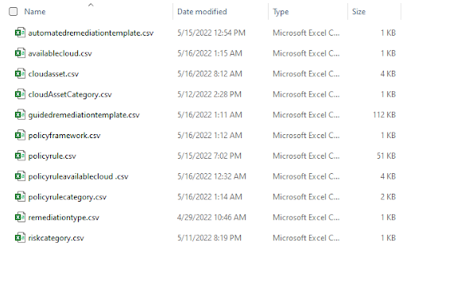
TASK-04
This was a collaborative task done with one of the interns. In this task, we have to fill data into google sheets, which contain 11 tables. We have to investigate the Triton confluence pages where all the policies and all the data are stated. We have to consider three compliance and rule repositories. they are-
AWS CIS v1.2.0
AWS Best Practice FW
PCI DSS 3.2.1

Slide 13
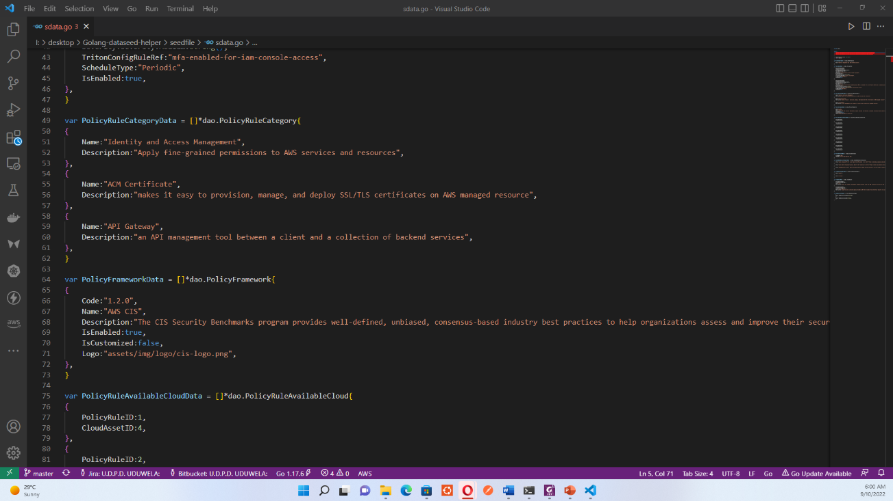
Task-05
This task was initiated to me because, at that time, I was manually creating this sdata.go file using the data we put into the policy compliances-sample data feed v1.0.0.xlsx sheet. It was a tough task to create structures manually. Therefore a separate Golang csv file reader program was built to automate this manual process.

Slide 14
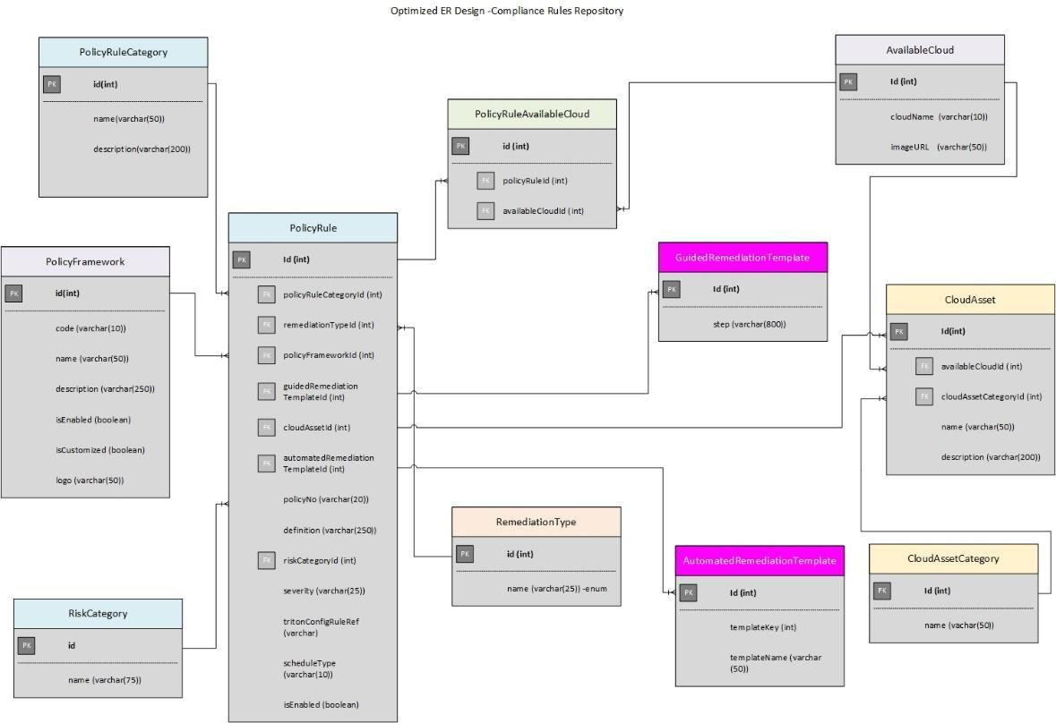
TASK-06
In the beginning, there was an Entity Relationship diagram(ERD) for the Compliance and rules repository. But it was not optimized. We had to only modify the ERD according to the comment given by the principal architect.

Slide 15
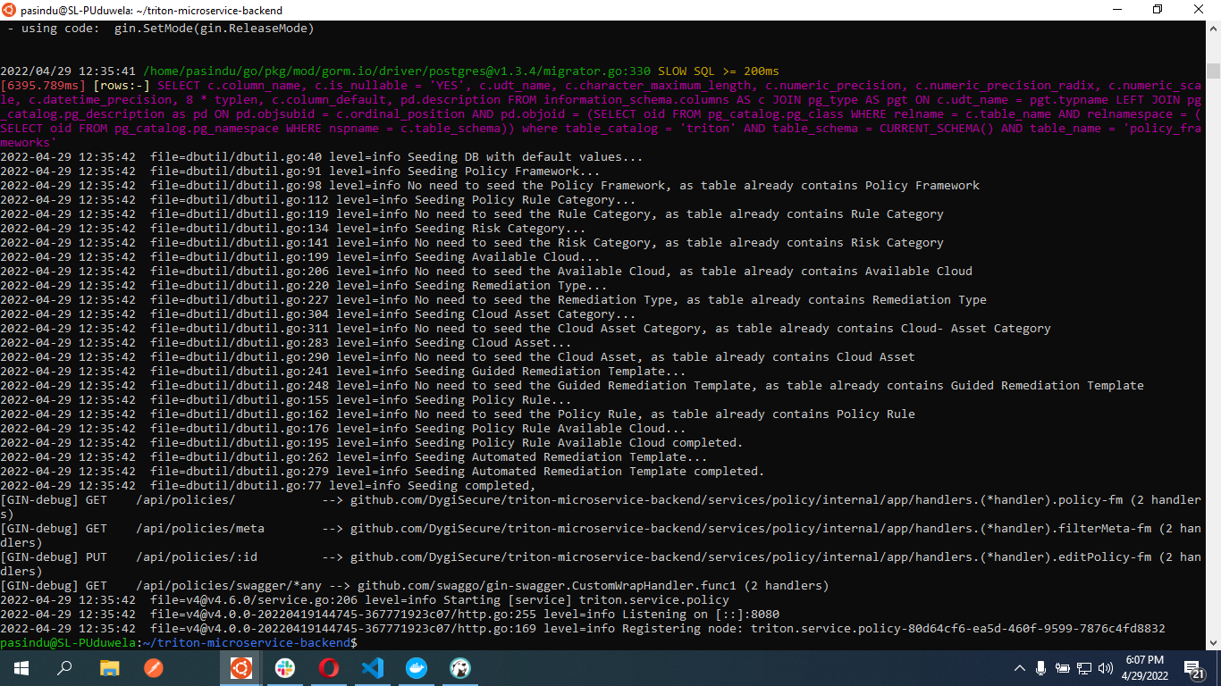
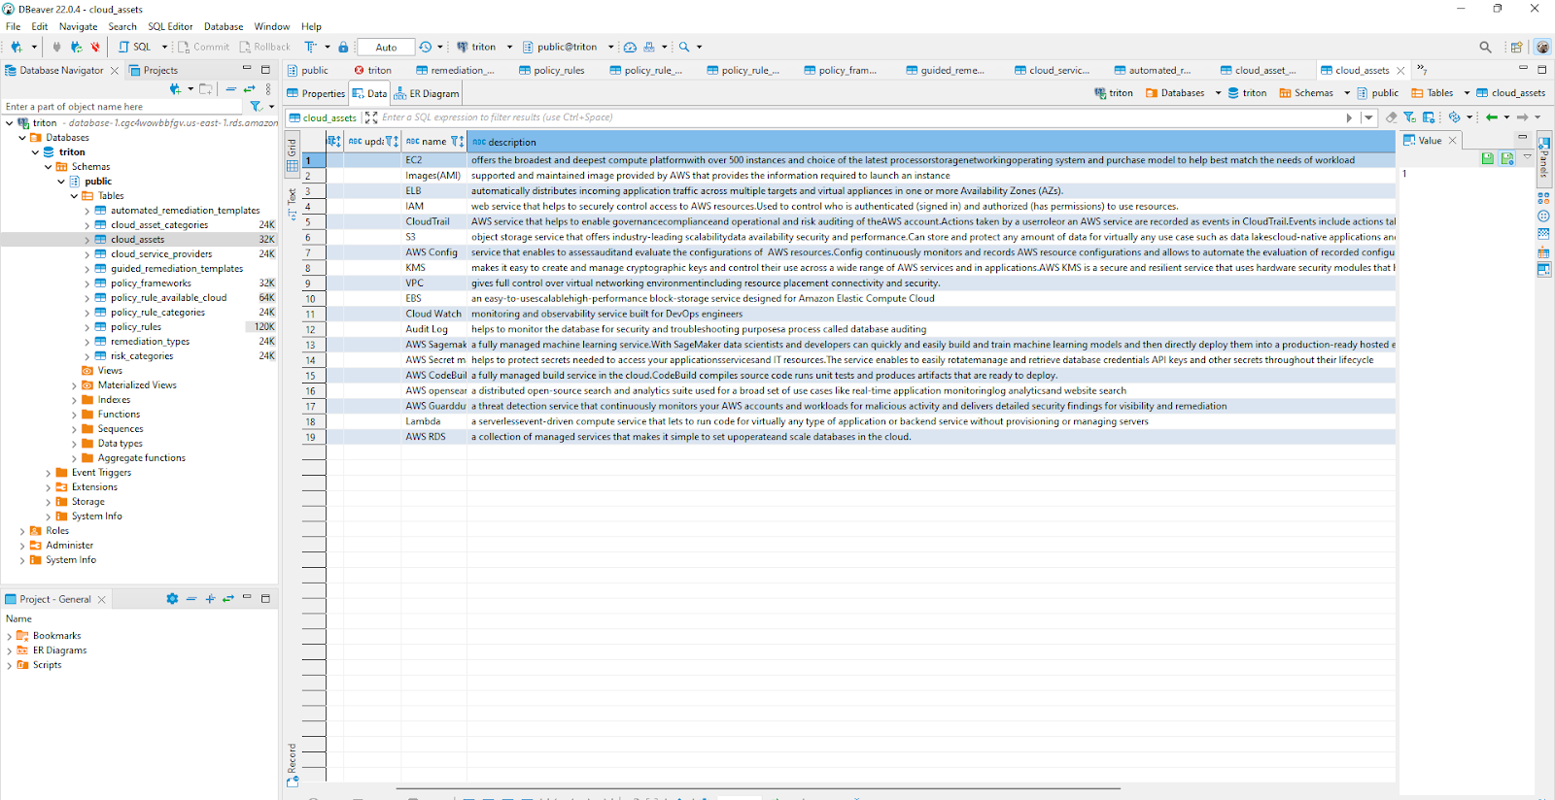
TASK-07
Another developer was initially build a data seeder using Golang. My task was to modify the seeder after the database structure changed.
Finally I have to check the data is seeded to the local PostgreSQL database container by checking the K9s error logs and check whether the data write into the database correctly by connecting the database to dbeaver software.
Kubectl port-forward service/triton/triton-db-postgresql 5432:5432

Slide 16
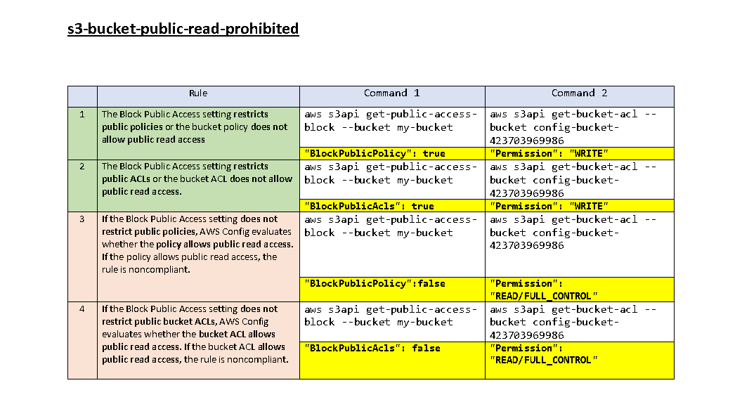
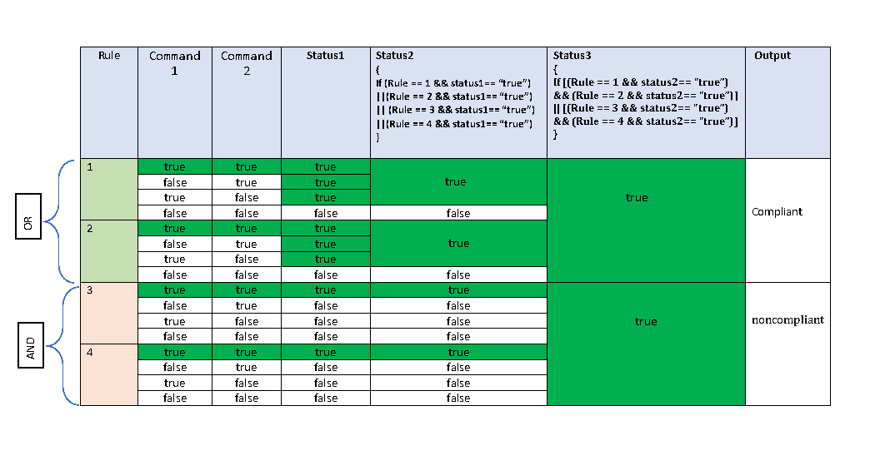
TASK-08
I have created a google sheet by Filling out all the A.W.S. managed config rules. Finally I have covered more than 250 rules. Bellow shows one rule as an example. The relevant sheet was shared with the respective developers and the architect.
Example 1 –
S3-bucket-public-read-prohibited - Check for buckets that allow public read access through bucket policy or ACL
Notes:
S3-bucket-public-write-prohibited, S3-bucket-replication-enabled, S3-bucket-server-side-encryption-
enabled

Slide 17
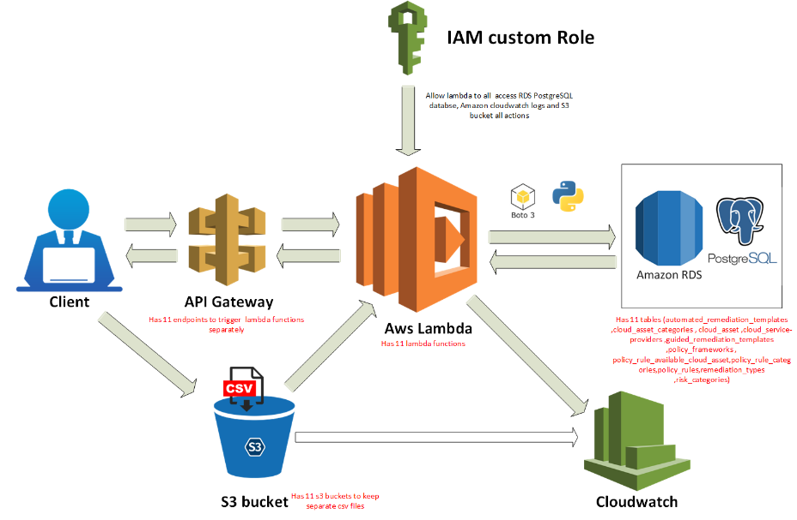
TASK-09
In the project, after deploying the application on AWS Elastic Kubernetes service(EKS), if the client needed to update the data-related policies from the database side, there were no possible methods to do it while the system was up and running. Therefore I have assigned a task to create an Extract Transform Load(ETL) to read files from the S3 bucket and load them into the AWS RDS PostgreSQL database.

Slide 18
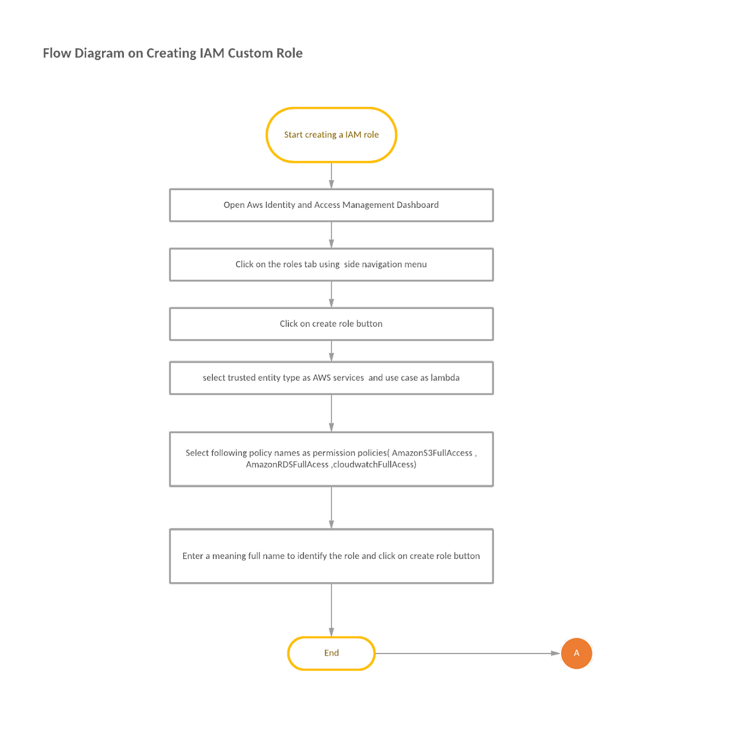
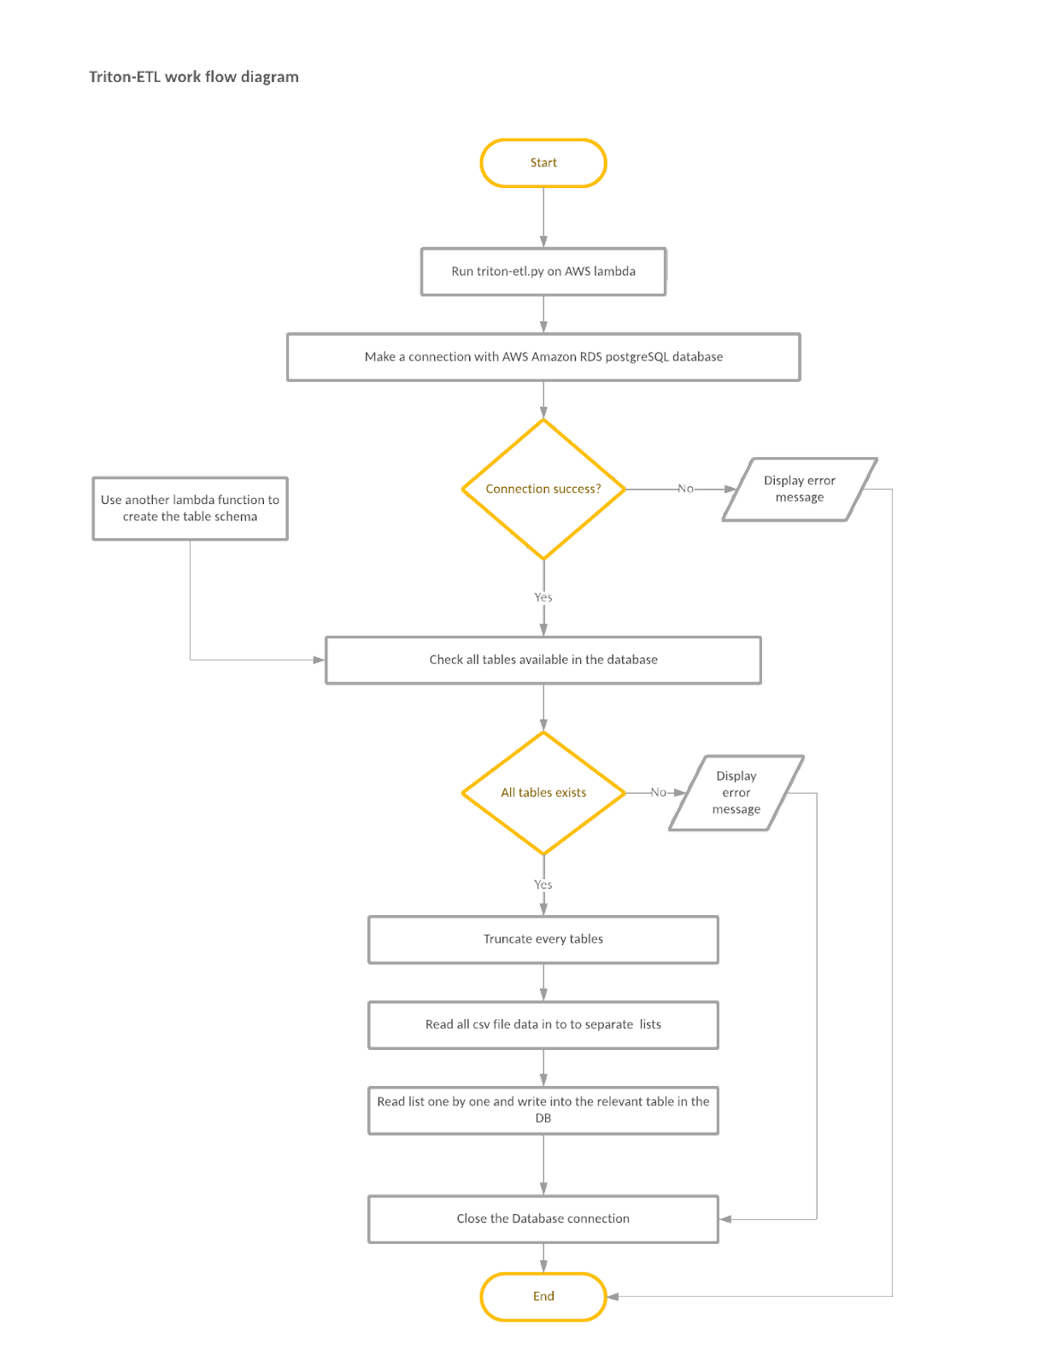
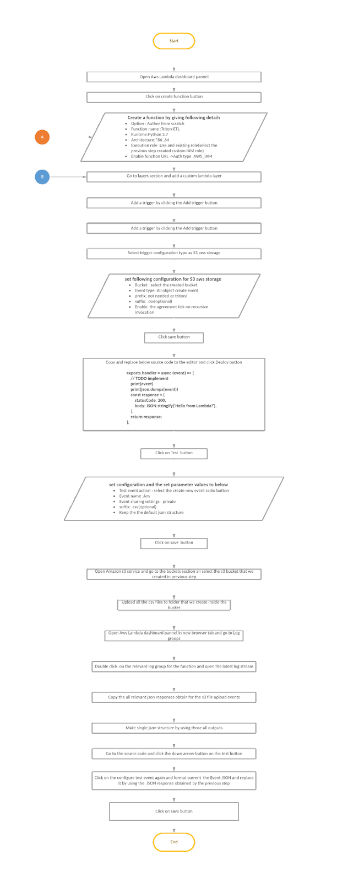
Proposed workflow diagrams for the designed ETL

Slide 19
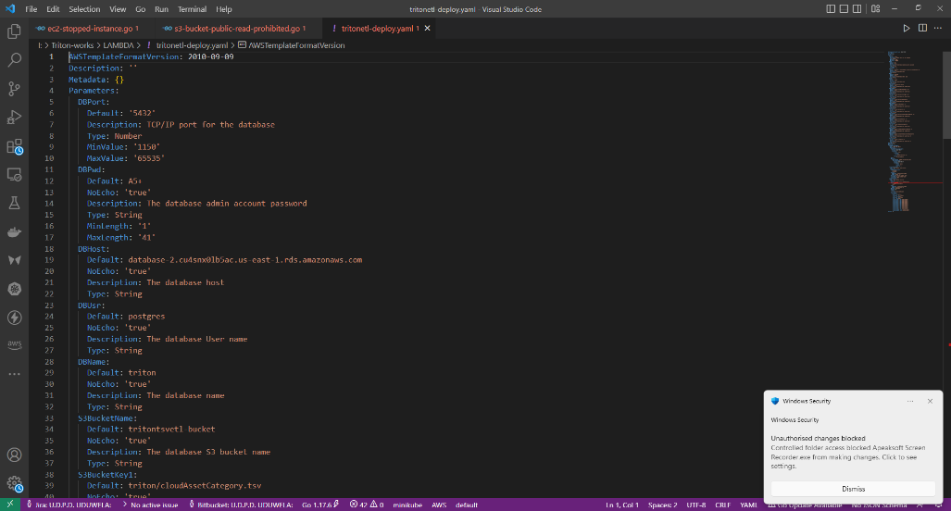
TASK-10
Here the task was to automate the Extract Transform Load(ETL) deployment process; for that, I had to use the AWS cloud formation service. In this project, I created the YAML. However, we can use either YAML or JSON to automate the process.

Slide 20
Applicant Tracking System
Notes:
As one of Mitra Innovation's main departments, the Human Resource Department is critical in recruiting employees for available positions in the organization. Currently, the Human Resource Department's staff manually maintains the Records of Recruitment with the association of the PeopleHR application. Since Recruitments take place often, it becomes a tough job for the officials to maintain a higher level of accuracy along with good efficiency and confidentiality in updating them into the system. Also, there are high chances of encountering data losses and erroneous entries since they are done manually.
-------------------------------------------------------------------------------------------------------------------------------------------------------------------------------
To address the above-mentioned drawbacks and difficulties in the existing system, it is suggested to develop a web application that replaces the current manual data capturing and visualization of the recruitment process. Department expects to maintain the recruitment process by overcoming overheads in the existing manual system and visualize the statistics associated with recruitments over months and weeks. -------------------------------------------------------------------------------------------------------------------------------------------------------------------------------

Slide 21
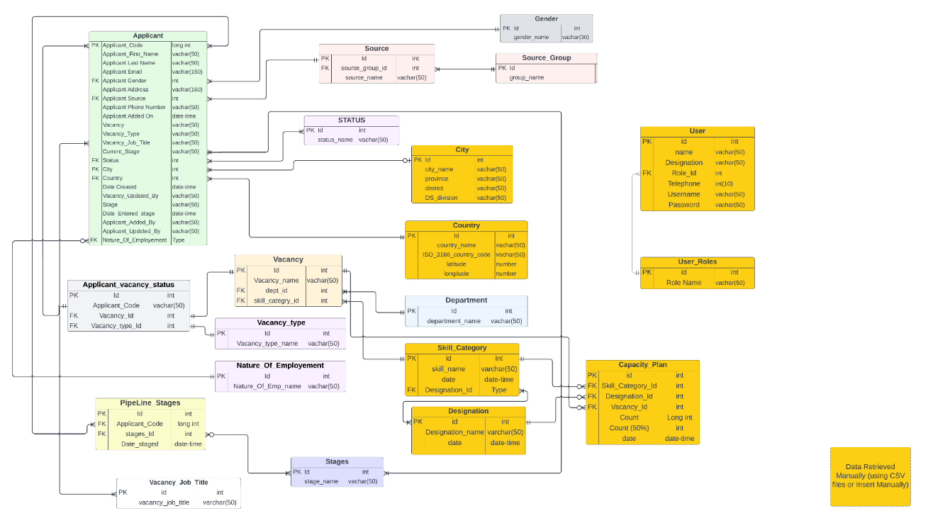
TASK-1
Create a relational database and design the ER diagram for ATS by observing the entities through the peopleHR sandbox environment.
Create a scheduler to sync both peopleHR data with currently propose ATS application.
Notes:
------------------------------------------------------------------------------------------------------------------------------------------------------------------------------

Slide 22
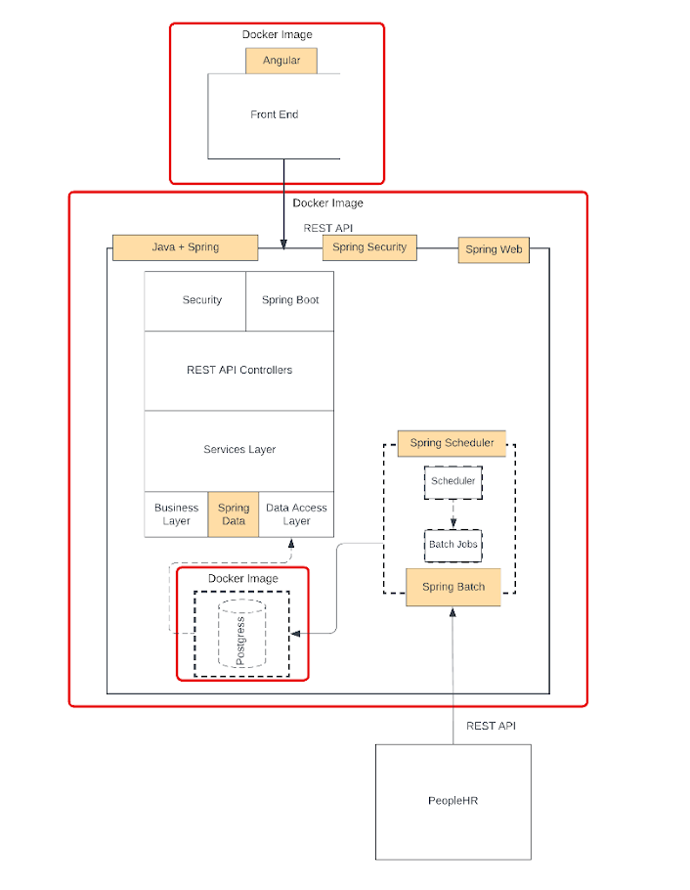
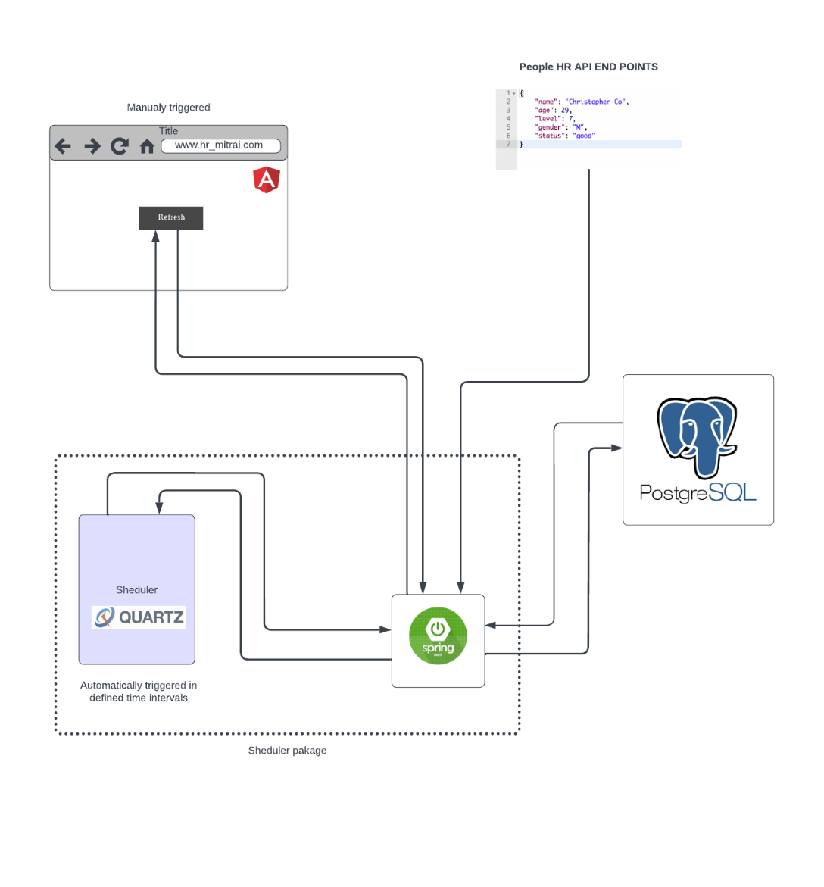
Notes:
These figures shows Seduler work flow diagram and project deployment structure

Slide 23
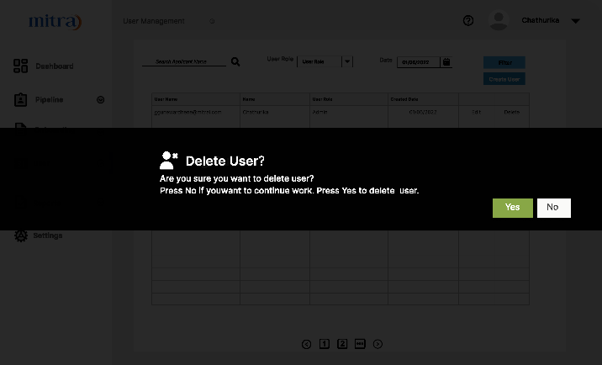
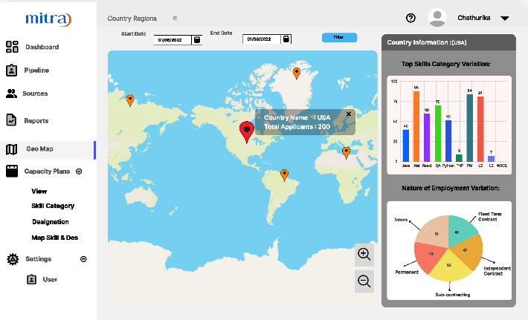
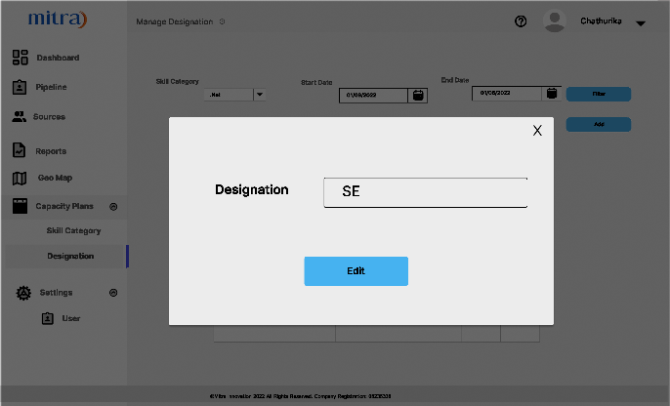
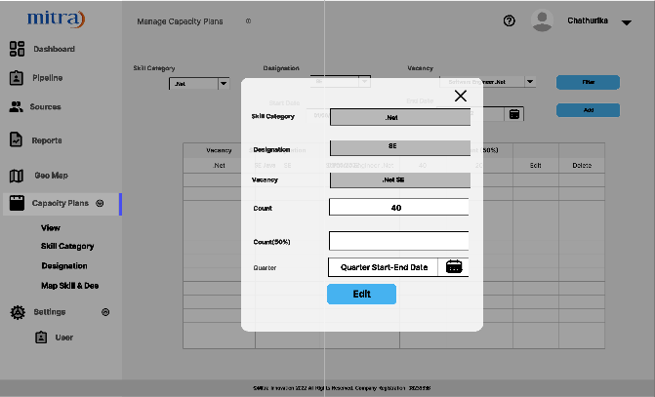
TASK-02
Designed some wireframes for the ATS using FIGMA UX/UI design tool.

Slide 24
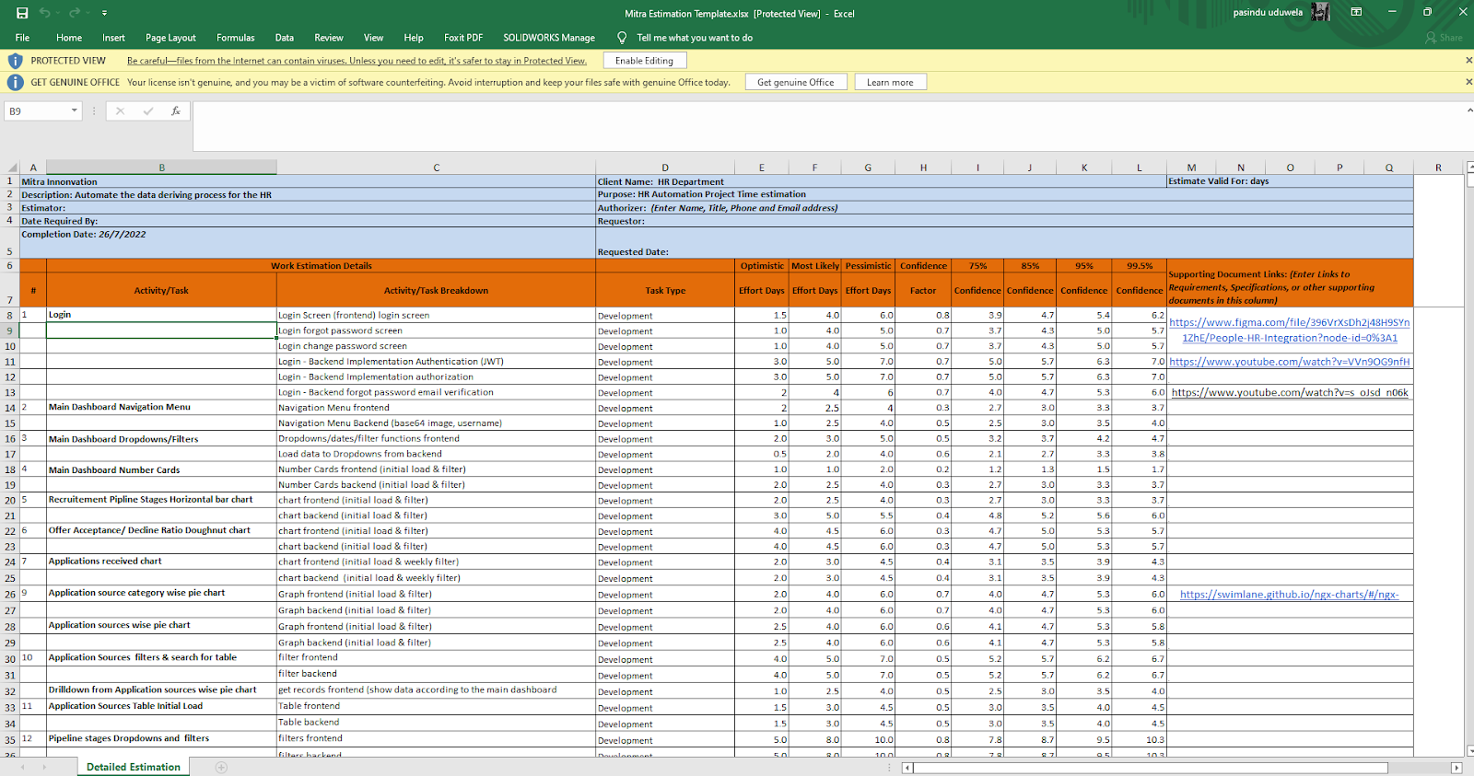
Task-03
This is a collaborative task assigned to all developers in which we have to fill the Mitra 3-point estimation sheet. The primary purpose is to get a rough idea about the project duration. This helps to draw the timeline using Atlassian project management tools.

Slide 25
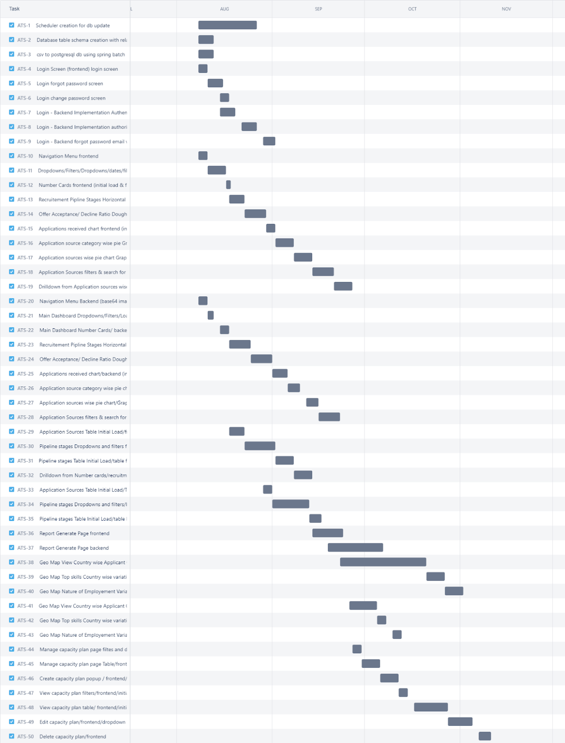
TASK-04
This was a collaborative task assigned to all the developers in the applicant tracking system project.
Project time line and the grant chart was designed using the Jira project management tools.

Slide 26
Things I have learned during my Internship
Technical
Non-Technical
Golang gin web framework
Kong
OpenID Connect
OAuth2.0
Swagger
ETL
AWS services
PostgreSQL
Neo4j
Data seeder
GORM
WSL
Load balancing
Docker
Kubernetes
Spring scheduler
Keycloak
Git/GitHub
Jira project management
Agile development
Team Burnout
Project Escalation
Adaptability
Documentation
Communication Skills
Presentation Skills
Pressure handling
Team Collaboration
Industry Best Practices

Slide 27
THANK YOU !

